Slide 1
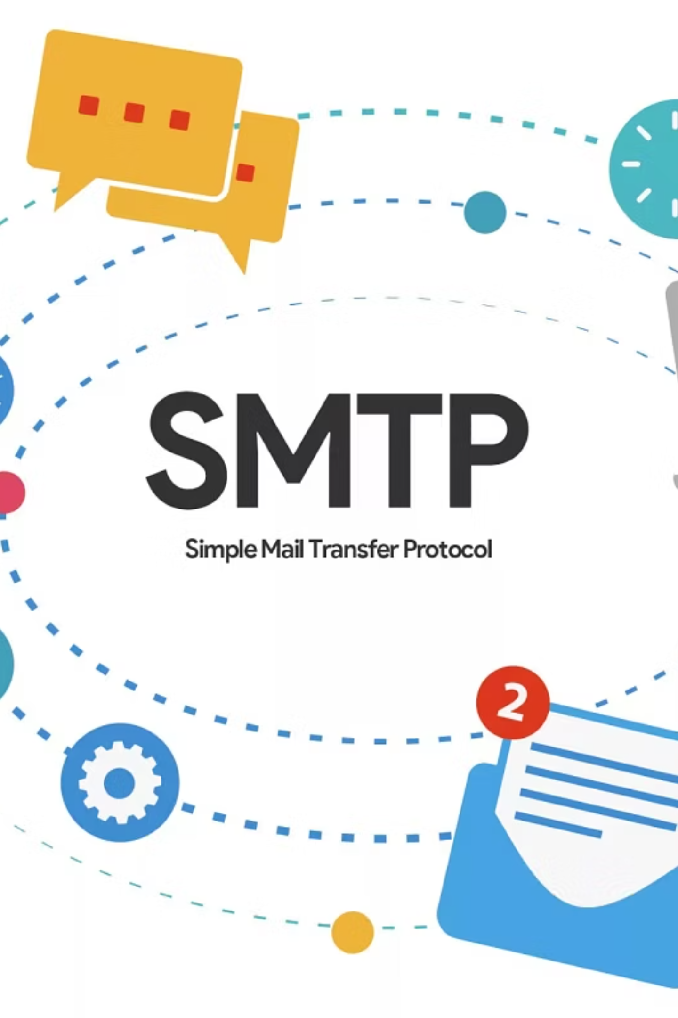
SMTP: The Foundation of Digital Communication
A Concise Overview of Simple Mail Transfer Protocol in Computer Networking
Presented by:
Supervised by:
Sabbir Ahamad
Mr. Dr. Nazrul IslamAssociate ProfessorICT, MBSTU
ID: IT22007

Slide 2



What is Simple Mail Transfer Protocol (SMTP)?
Standard Protocol
Message Exchange
Core Function
The primary, application-layer protocol used to send and relay email between servers (MTAs).
Defines the rules for communication between email systems, enabling the transfer of electronic mail.
Crucial for pushing emails from a sender's client (MUA) or server (MTA) to a recipient's server.
SMTP acts as the digital post office worker, ensuring mail leaves the sender's domain and reaches the recipient's server reliably.

Slide 3
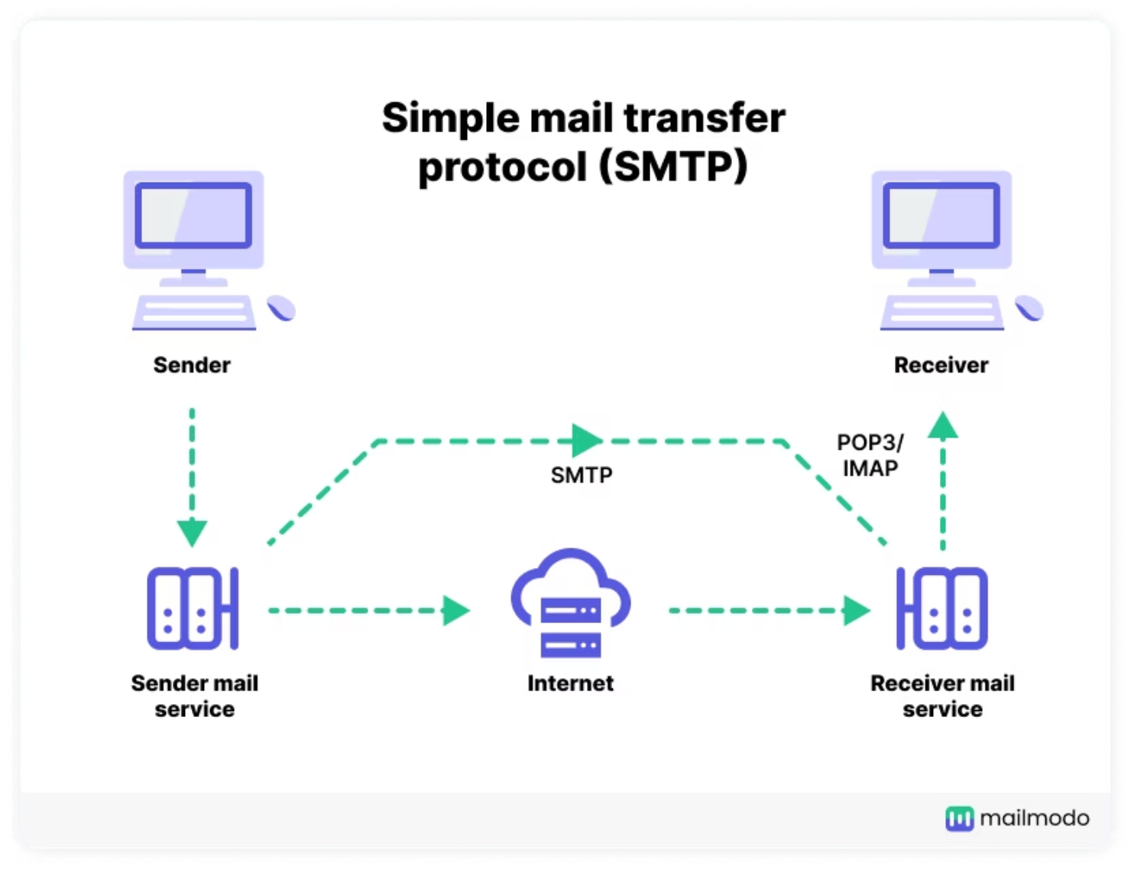

SMTP's Role: Sending and Delivering Mail
SMTP is specifically designed for the transmission of messages, handling the connection and negotiation between mail servers.
Message Initiation
An MUA (sender) connects to its local MTA to begin the transfer process.
Relay and Routing
MTAs communicate with each other, using DNS records (MX records) to route the email across the internet.
Final Delivery
The destination MTA accepts the message and passes it to the MDA for placement in the recipient's mailbox.

Slide 4



The Three Agents: SMTP Architecture Components
Email transfer involves collaboration between three specialized agents, each performing a distinct function in the mail lifecycle.
1. Mail User Agent (MUA)
2. Mail Transfer Agent (MTA)
3. Mail Delivery Agent (MDA)
The client software (e.g., Outlook, Gmail web interface) used by the end-user to compose, send, and read emails.
The core server responsible for relaying mail between domains. It listens for incoming SMTP connections (e.g., Sendmail, Postfix).
Takes the message from the final MTA and delivers it locally into the recipient's mailbox (often part of the destination MTA).

Slide 5

SMTP Process Flow: From Sender to Recipient
A high-level view of how an email message is pushed across the network using the SMTP protocol.
Sender → Sending MTA
Sending MTA → Receiving MTA
Receiving MTA → Mailbox (MDA)
Recipient MUA Retrieves
Key Interaction: The entire relay path, from step 1 to 2, is governed by SMTP communication (client-server interactions).

Slide 6
The SMTP Conversation: Commands and Responses
SMTP operates as a text-based, request-response protocol, where the client sends commands and the server replies with status codes (e.g., 250 OK).
HELO / EHLO
MAIL FROM:
RCPT TO:
Initiates the session and identifies the client to the server.
Specifies the reverse path (sender's email address) for bounced mail.
Identifies the forward path (recipient's email address). Used multiple times for multiple recipients.
DATA
QUIT
Indicates that the body of the email message (headers and content) is about to be sent.
Requests termination of the SMTP session.

Slide 7

Ports and Security Protocols
Modern email environments use specific ports and encryption methods to ensure secure transmission and compliance.
Port 25
MTA-to-MTA
Original, default SMTP port for server-to-server relay. Often blocked by ISPs due to spam concerns.
Port 587
MUA-to-MTA
The current standard submission port for client-to-server connection. Requires authentication and uses STARTTLS.
Port 465
Legacy SMTPS
Previously used for SMTP over SSL (SMTPS). Though deprecated, it is still used by some older services.
Security Layer: STARTTLS upgrades an unencrypted connection (like Port 587) to an encrypted one (TLS/SSL), protecting data during transmission.

Slide 8
Advantages and Limitations of SMTP
Key Advantages
Limitations & Challenges
Ubiquity: It is the universally recognized standard for email transfer, ensuring interoperability.
No Authentication (Legacy): Originally lacked security, leading to widespread spam and spoofing.
Reliability: Uses a "store-and-forward" mechanism to handle temporary failures and ensure delivery.
Transmission Only: SMTP cannot retrieve messages; it only pushes them to the recipient server.
Scalability: Robust architecture handles the massive volume of global email traffic efficiently.
Complexity: Configuration and maintenance of modern, secure MTAs can be complex.

Slide 9
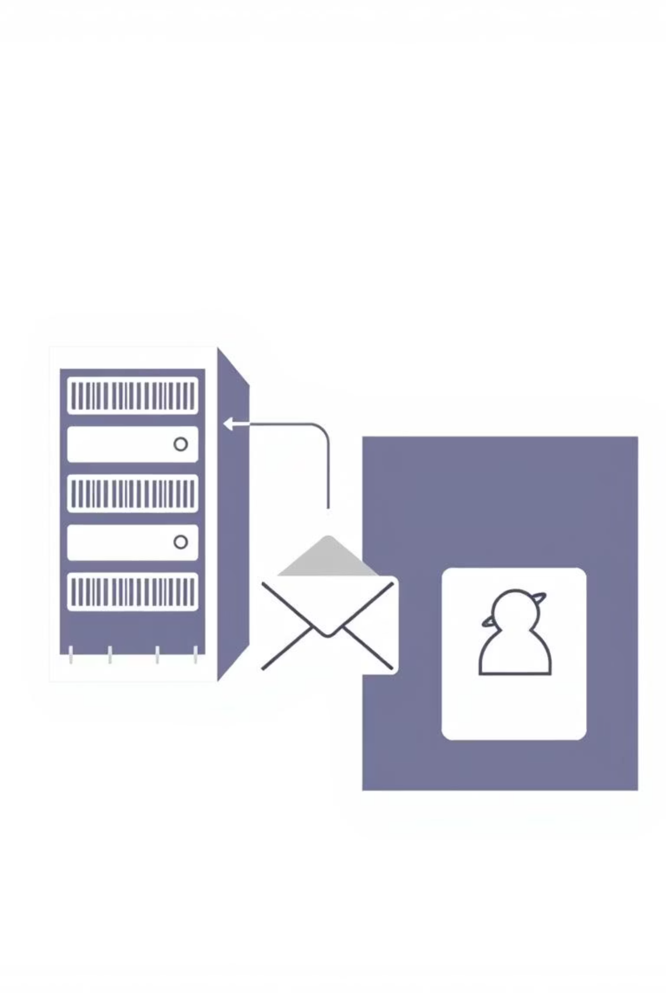



SMTP vs. Retrieval Protocols (POP3/IMAP)
SMTP sends mail, while other protocols are necessary for the recipient to access and manage the received messages.
SMTP (Sending)
POP3 (Retrieval)
Handles the push of messages from client to server, and server to server. It is strictly a transmission agent.
Post Office Protocol version 3 downloads the email from the server and typically deletes the server copy.
IMAP (Retrieval)
Internet Message Access Protocol allows the client to access and manage emails on the server, keeping local and server copies synchronized.

Slide 10
Conclusion: SMTP's Enduring Importance
SMTP remains the cornerstone of all electronic messaging, continually evolving to meet modern security demands.
1
587
3
Transmission Standard
Modern Submission Port
Key Agents
Essential protocol for message delivery and server-to-server communication.
Standard for MUA-to-MTA connection, prioritizing security via STARTTLS.
Involves MUAs, MTAs, and MDAs working in concert to ensure end-to-end delivery.
The robustness and simplicity of SMTP have cemented its role as the irreplaceable backbone of global email infrastructure.

Slide 11

Thank You!
We appreciate your valuable time and attention in exploring the fundamentals of SMTP and its critical role in digital communication.
Questions?
Sabbir AhamadIT22007

